Slide 1
Richard Brynteson, Skype and Teams MVP Web: theargylemvp.com Twitter: @rbrynteson GitHub: @rbrynteson
Microsoft Teams
Migration or Upgrade

Slide 2

Welcome to the Fall Admin Workshop Day!
Please help us drive event awareness by tweeting and posting about your experience at the Workshop:
@o365MN #M365WorkshopDay
Please join us following the sessions for Happy Hour… Admin Ales, Workshop Wine, and more!

Slide 3







Thank You To Our Sponsors!
Remember to Stop by the Booths for “Vendor Bingo”

Slide 4
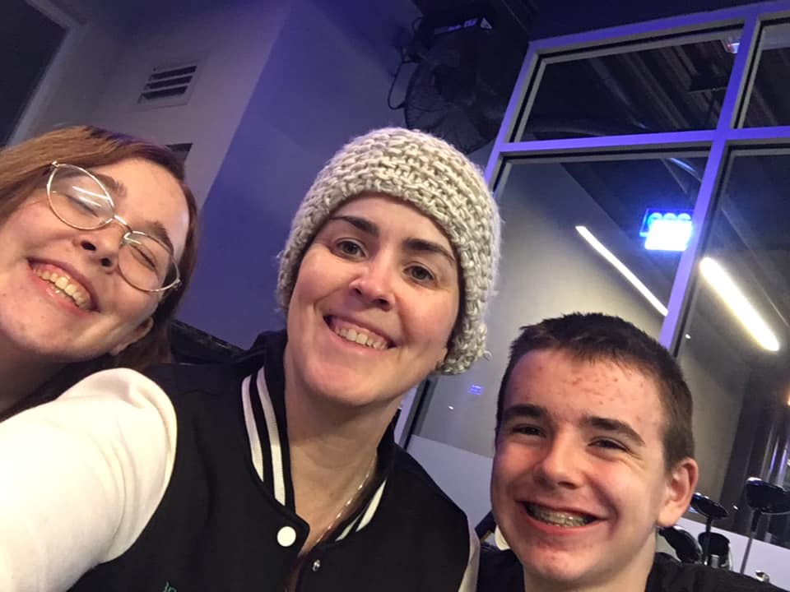
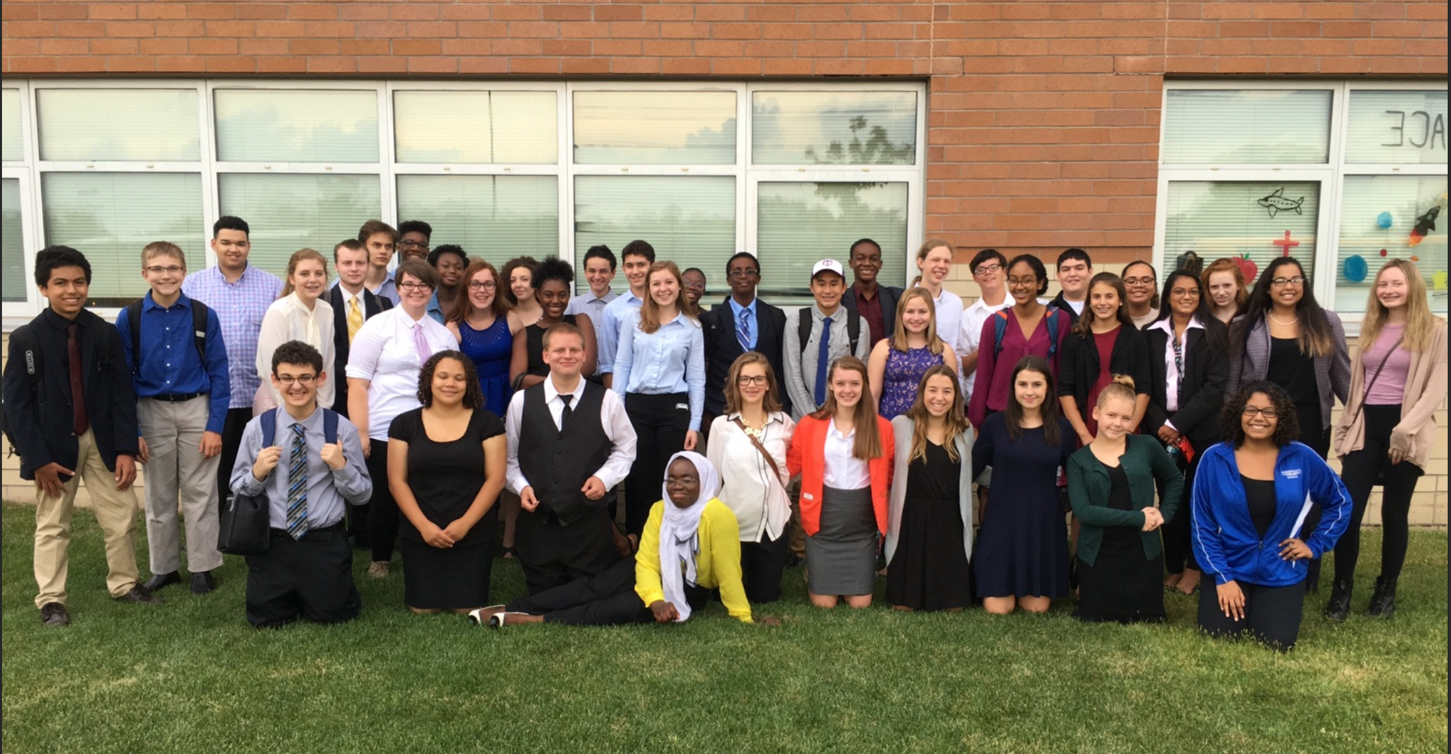
Introduction

Slide 5
Agenda
What is upgrade
Planning your path to Teams
Experiences in coexistence
Managing coexistence and upgrade
Planning
Q & A

Slide 6
What’s New in the Community

Slide 7
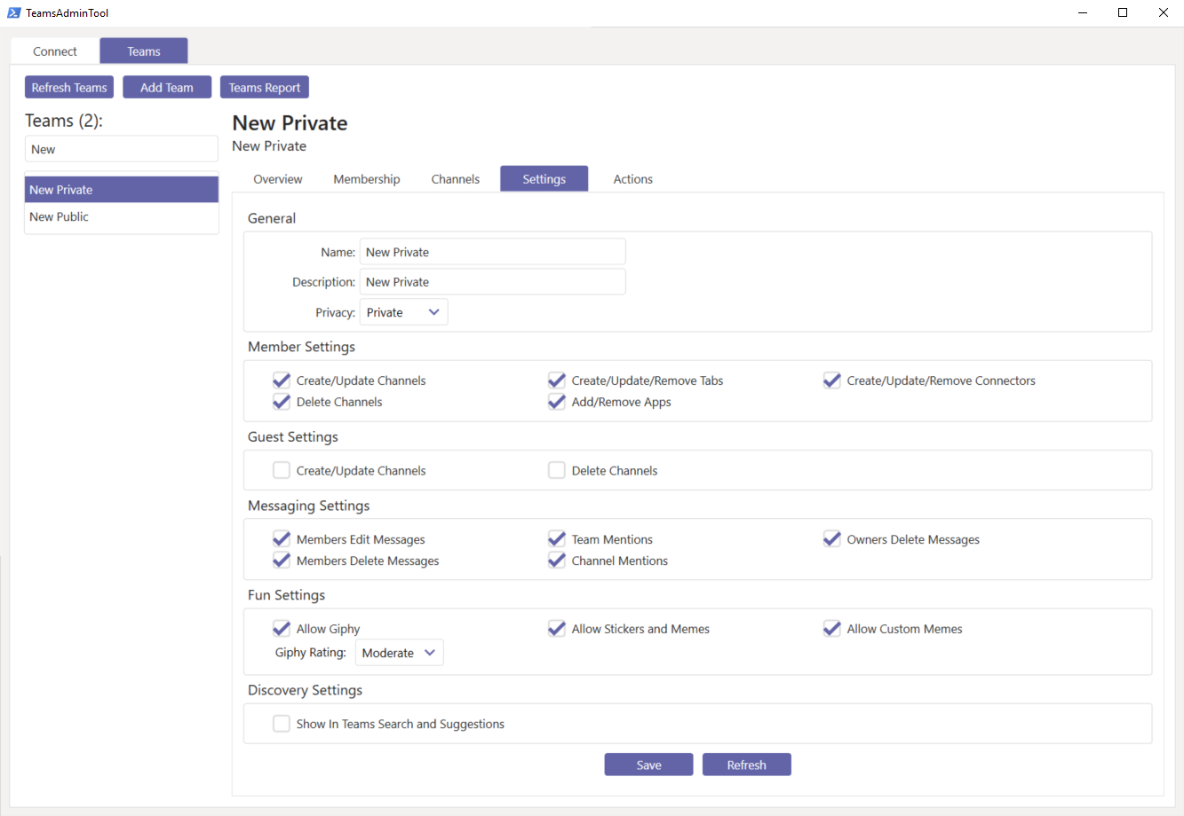
TeamsAdminTool
Lee Ford, PowerShell leveraging GraphAPI tool to manage teams
https://www.lee-ford.co.uk/teams-admin-tool/
Backup, Restore and Move Between Tenants

Slide 8
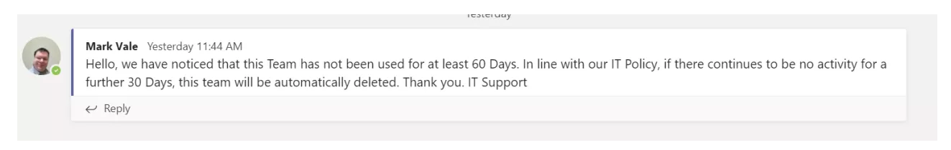
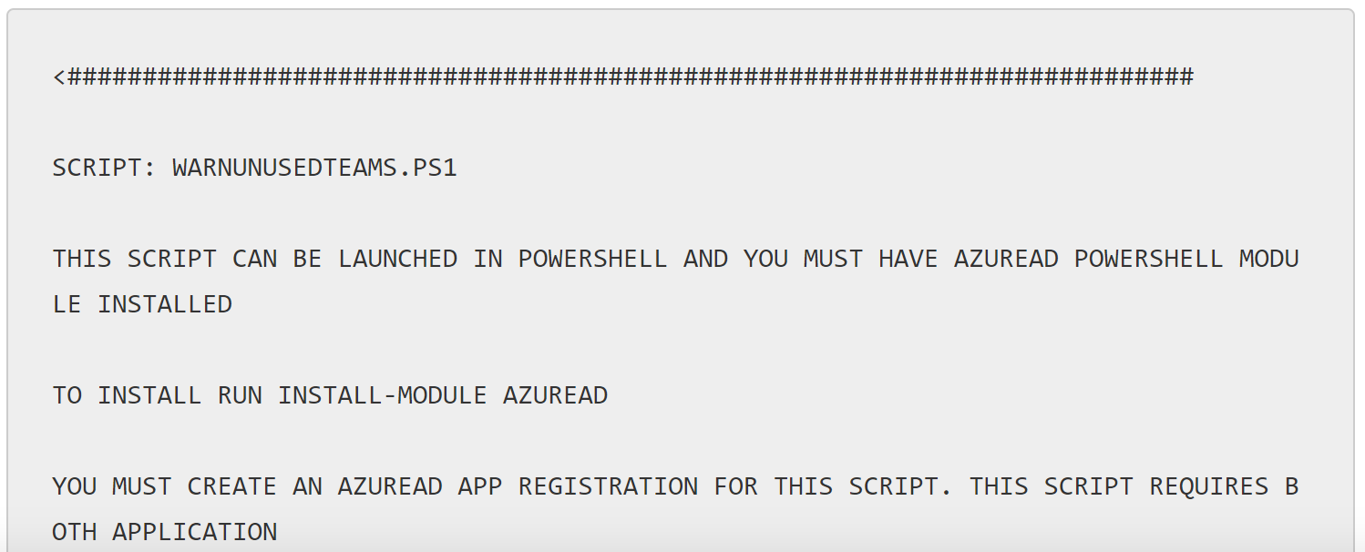
Unused Teams
Mark Vale, MVP, PowerShell tool to determine last message, file posted
https://blog.valeconsulting.co.uk/2019/05/16/unused-teams-audit-warning-with-microsoft-teams-graph-api/

Slide 9

The next big thing…

Slide 10

Part 1: What is the “Upgrade”

Slide 11




Upgrade is more than a technical migration
People don’t automagically change
Resistance is a normal, human behavior takes time
Shadow IT
People and change are not one-size-fits-all
Organizations are made up of innovators, laggards and everyone in between
Technical and user readiness go hand in hand
Plan, pilot and deploy both readiness activities together
is more prominent than ever
80% admit to using their communication tool of choice¹
¹“What is Shadow IT?”, https://www.skyhighnetworks.com/cloud-security-university/what-is-shadow-it/ (accessed March 2017)

Slide 12
Upgrade planning considerations
Teams is more than a technical migration; it’s about people change
Adopting Teams is a user’s choice; empower users to choose Teams
Flexible upgrade approaches empower you to choose the right upgrade journey for your organization
A solid foundation keeps everyone aligned and helps ensure upgrade success as well as sustained business outcomes

Slide 13
Part 2: Planning your path to Teams

Slide 14

Which coexistence path should customers take?
Microsoft offers flexibility for customers to choose their upgrade path on the road to Teams Only
Teams side-by-side to SFB with Chat, Meetings & Calling
Considerations:
Skype for Business Online and most on-premises
Capabilities available in both SFB and Teams
Enables quick velocity move to Teams
Teams side-by-side to SFB with selected features (Collab, Meetings)
Considerations:
More complex environment with on premises enterprise voice
No overlapping capabilities between SFB and Teams
Designed with longer co-existence period in mind

Slide 15




Side-by-Side with overlapping capabilities
Introduce Teams side-by-side to Skype for Business with Chat, Meetings and Calling enabled *
Drive your adoption program
Upgrade all users or one cohort at the time to be using Teams only
Collaboration
Chat
Calling
Meetings
Chat
Calling
Meetings
*Calling features are VoIP only until Teams only experience

Slide 16
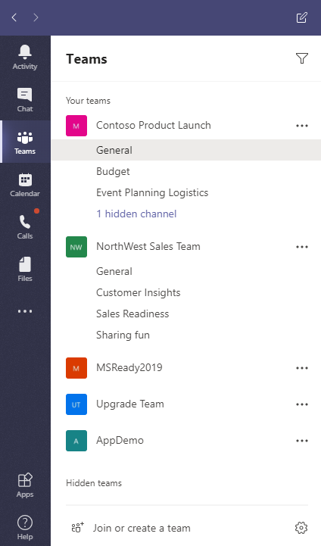
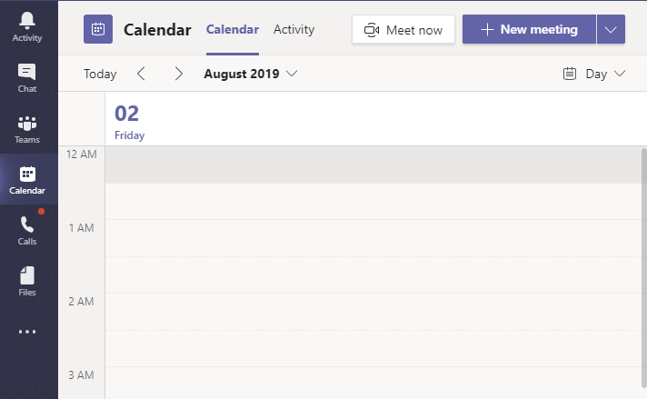
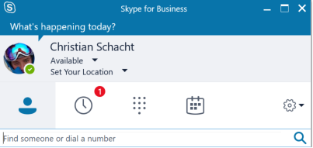
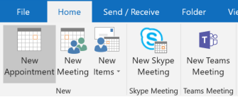
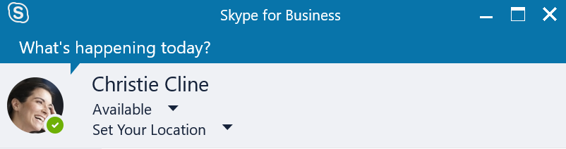
Users use both products side-by-side Full Side-by-Side User runs both applications with “all” features available
Skype for Business
Teams
Chat
Calling
Meetings
Chat
Calling
Meetings
Collaboration
Calling and Chat
Meetings
Receives chats and calls in same client as the one used by originator
Can initiate calls and chats from either client
Presence is separate
No interoperability
Federated chat and calls land in SfB
PSTN calls in SfB
Meeting scheduling available on both services
Outlook shows both add-ins
Can join meetings from the respective clients
Default; requires strong Adoption and Change Management, adoption saturation prior to upgrade

Slide 17
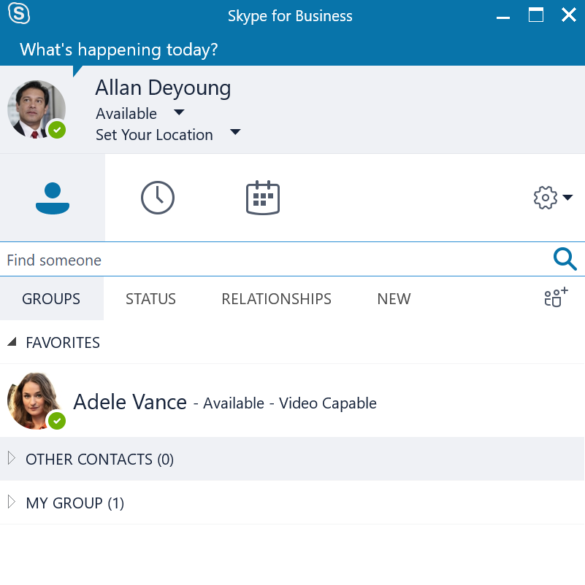
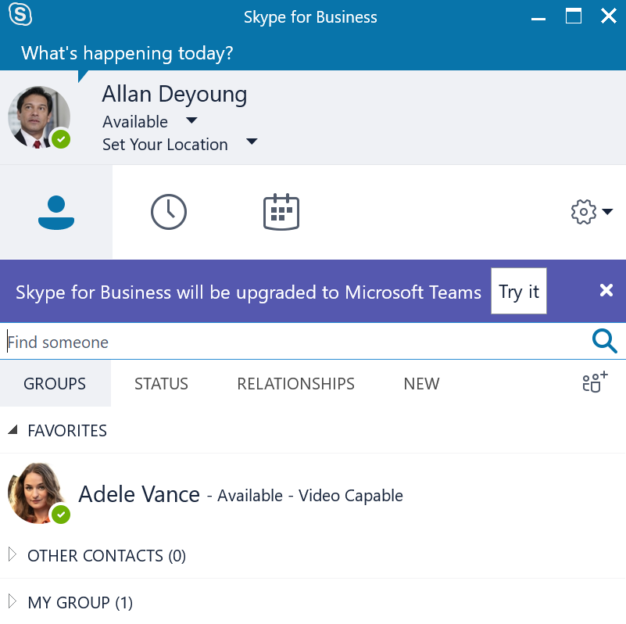
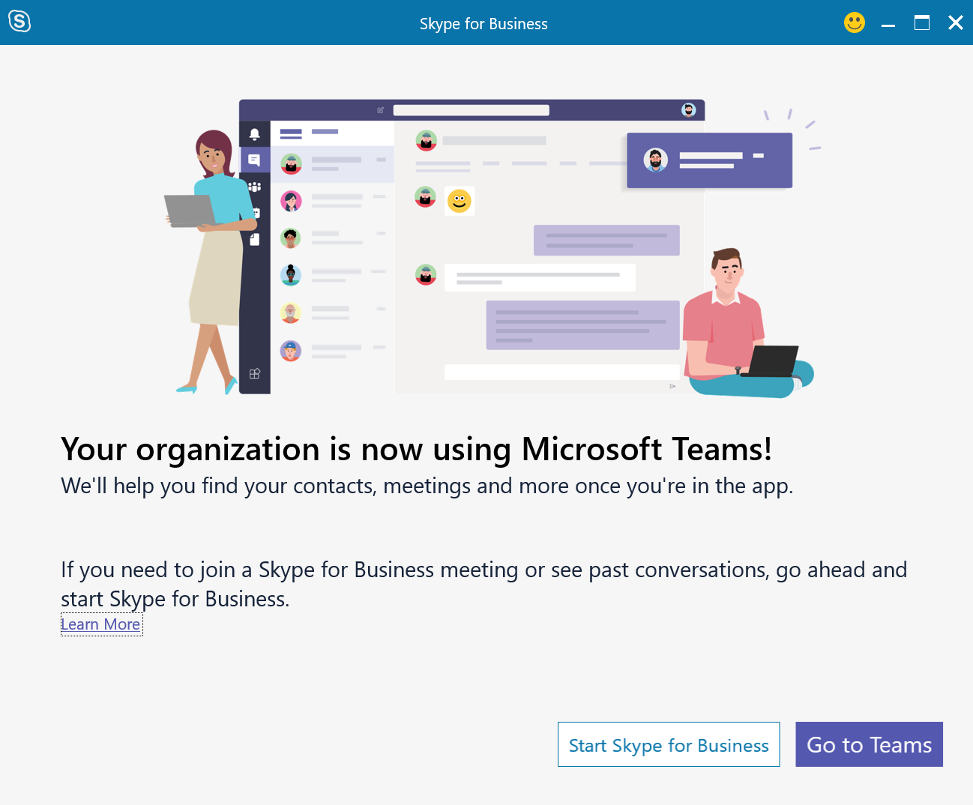
Skype for Business upgrade journey What users will see at each phase
Upgrade has not started
User notified of impending upgrade
User upgraded to Teams
Skype for Business client remains the same
User can try Microsoft Teams; the option facilitates download if client is not present
Skype for Business Outlook Meeting add-in is removed and Skype for Business integrations with Office are disabled. Current Outlook Contact Card now maps to Teams

Slide 18
Considerations & impact
Feature requirements & overlap
Chat and calling will be available in both SFB and Teams
Meeting scheduling and joining is available in both products
Moving users all at once or in cohorts
All at once: Ideal option for best user experience Quick velocity: All users have the same capability and experience at once which simplifies adoption
Cohorts: Increased success when users adopted all the key scenarios in Teams Slower velocity: Large organizations may move slower, however when Teams deployed to all users there will not be interop experiences
Additional considerations
Chat messages and calls from federated customers will be received in Skype for Business until you move to Teams Only
Phone System capabilities will only be available when users in Teams Only
HID and meeting room devices

Slide 19
Critical Success Factors
Adoption and Change Management
User adoption, not IT actions, governs the overall timeline
Client Use
All Users in Full Side-by-Side cannot receive interop chats or calls from Skype for Business. Incoming communication that originated from Teams will land in Teams; Teams must run. Users need to be comfortable with incoming communication landing on either client On-prem users must use Skype for Business for federation
Do NOT move users to Teams Only mode until end of migration.
Saturation Plan
Must wait to start upgrading users to Teams Only until Teams adoption is saturated

Slide 20
Skype for Business Meeting Experience After Teams Only

Slide 21
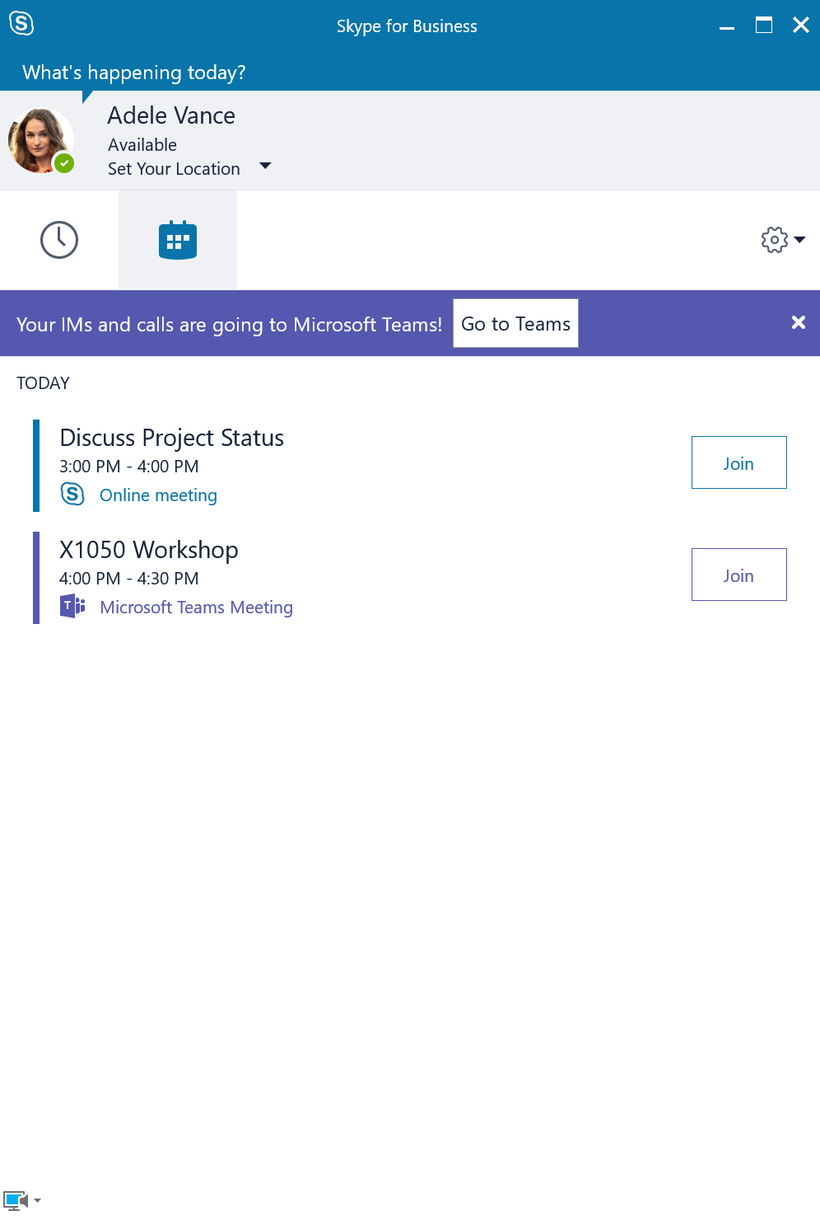
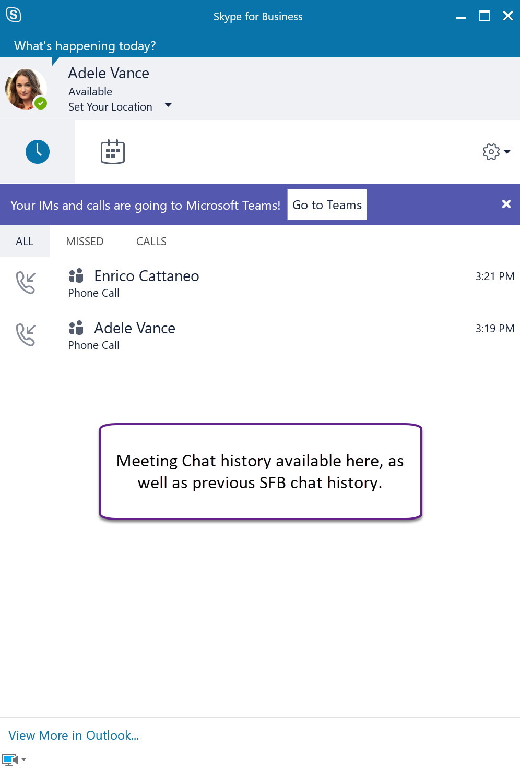
What happens to Skype for Business during upgrade?
Skype for Business meetings-only client configuration (automated, recent clients only)
Clear notification to user
Guidance to user
Easy link to Teams
Also enables access to Skype for Business client
Specially adapted client
Meetings focused
Only the meetings and past conversations tabs shown
Chat and calling disabled
Meetings
Previous Skype for Business meetings migrated to Teams
Can still attend any Skype for Business meeting in Skype for Business (experience unchanged from before upgrade)
Can’t schedule new Skype for Business meetings (plugin replaced)
Schedules Teams meetings
Clicking on a Teams meeting in Skype for Business redirects to Teams
Clicking on a Skype for Business meeting in Teams redirects to Skype for Business

Slide 22
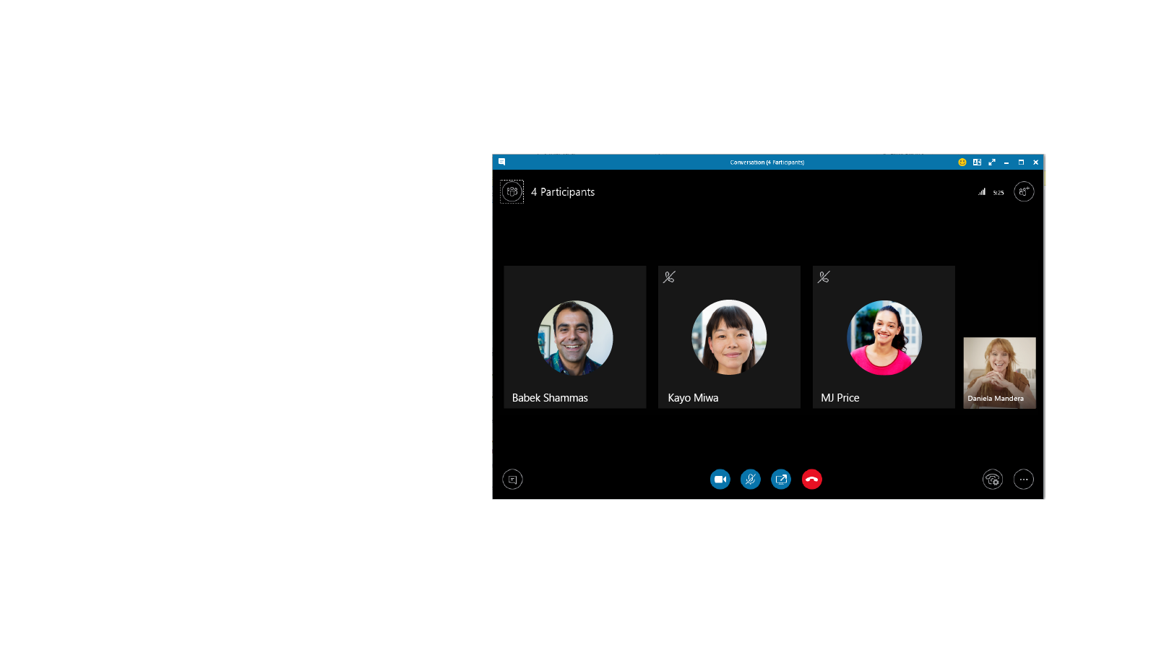
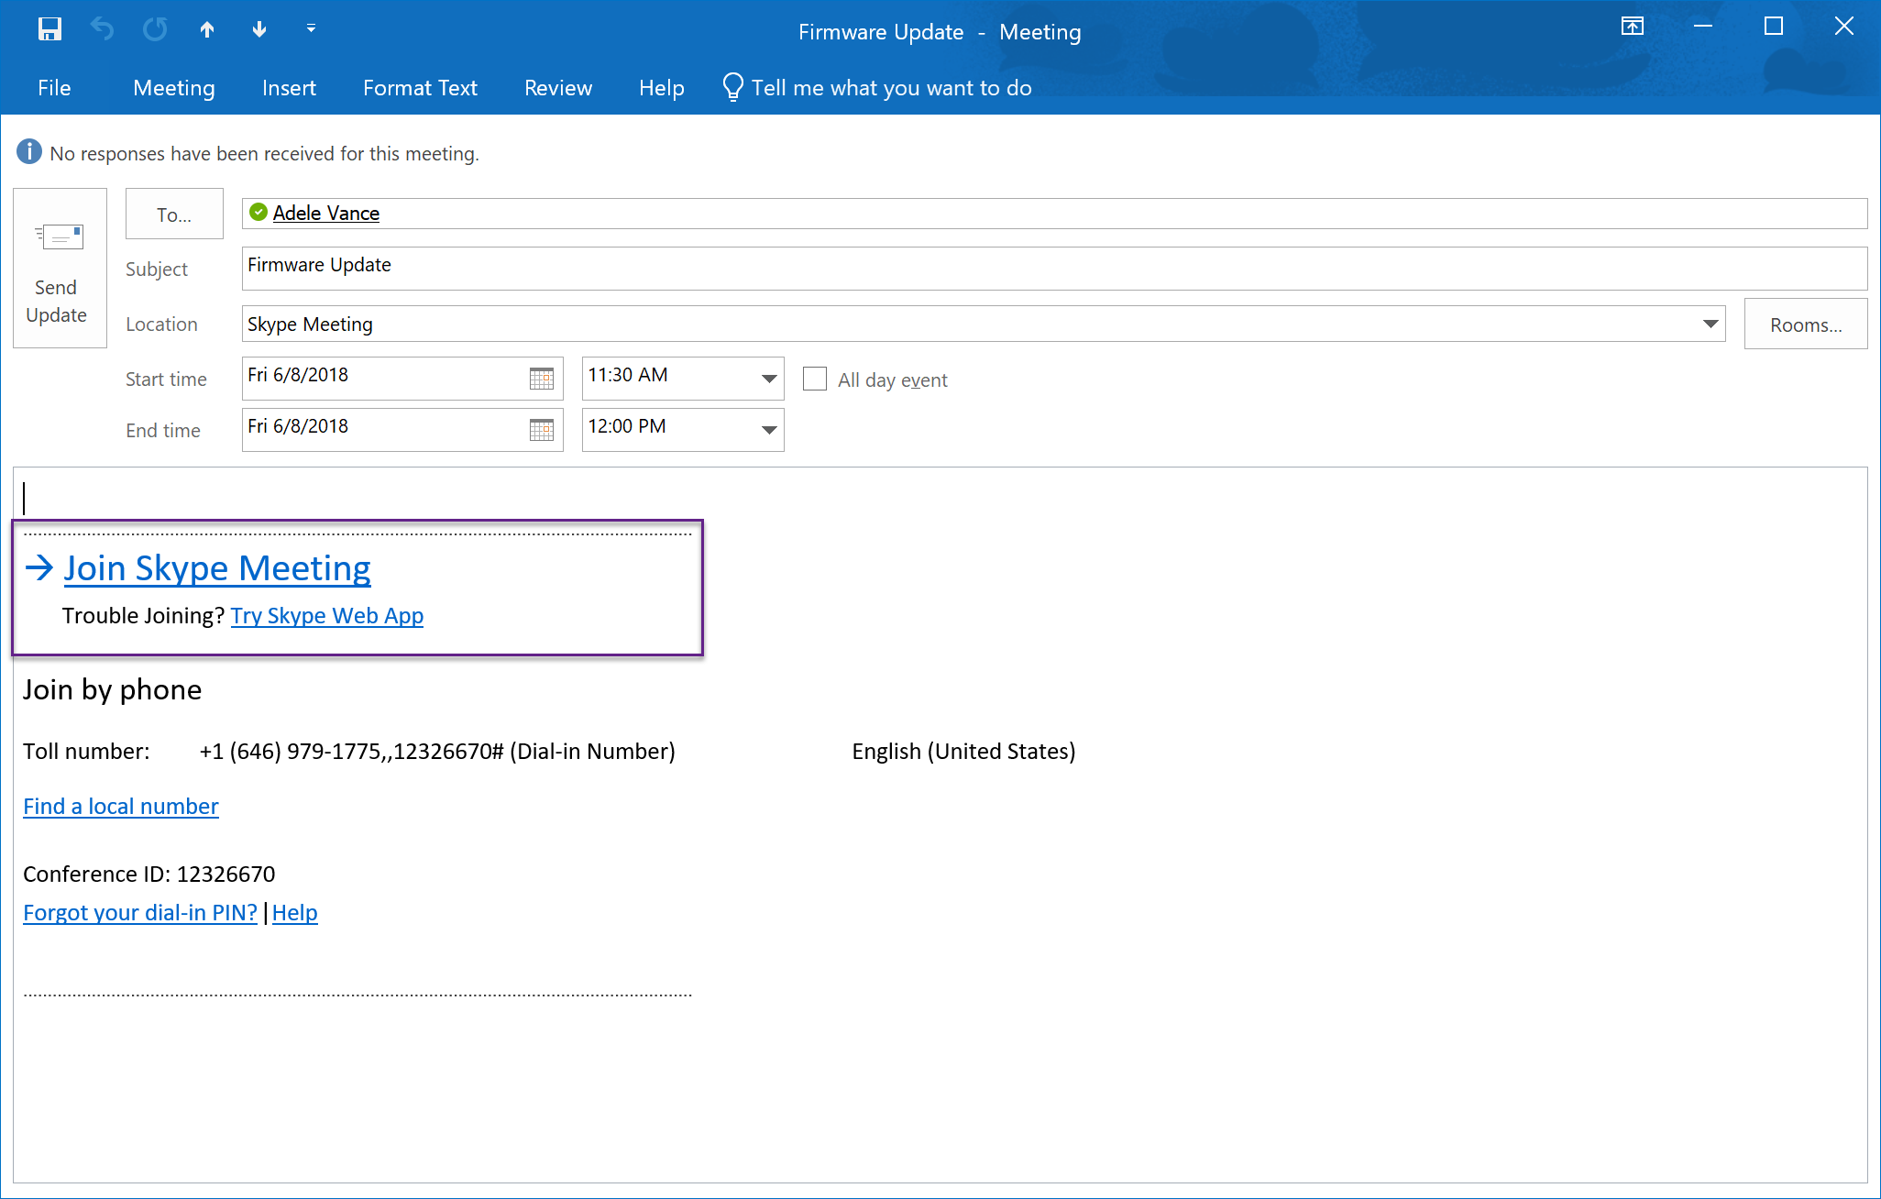
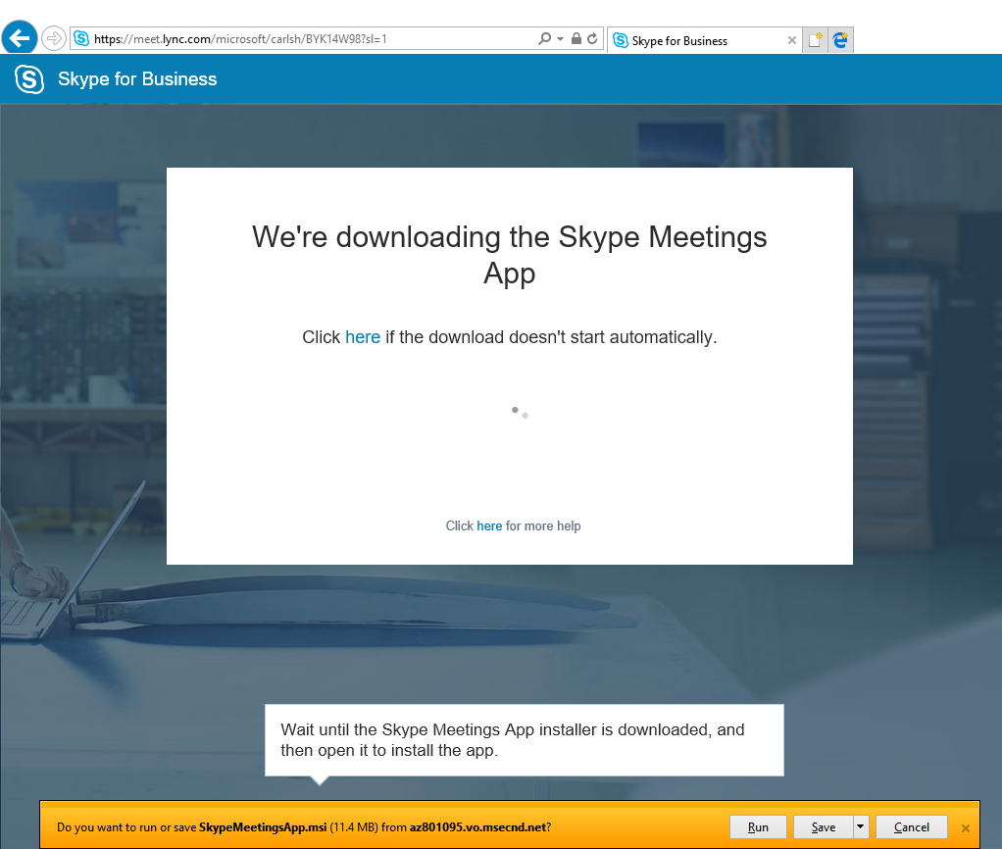
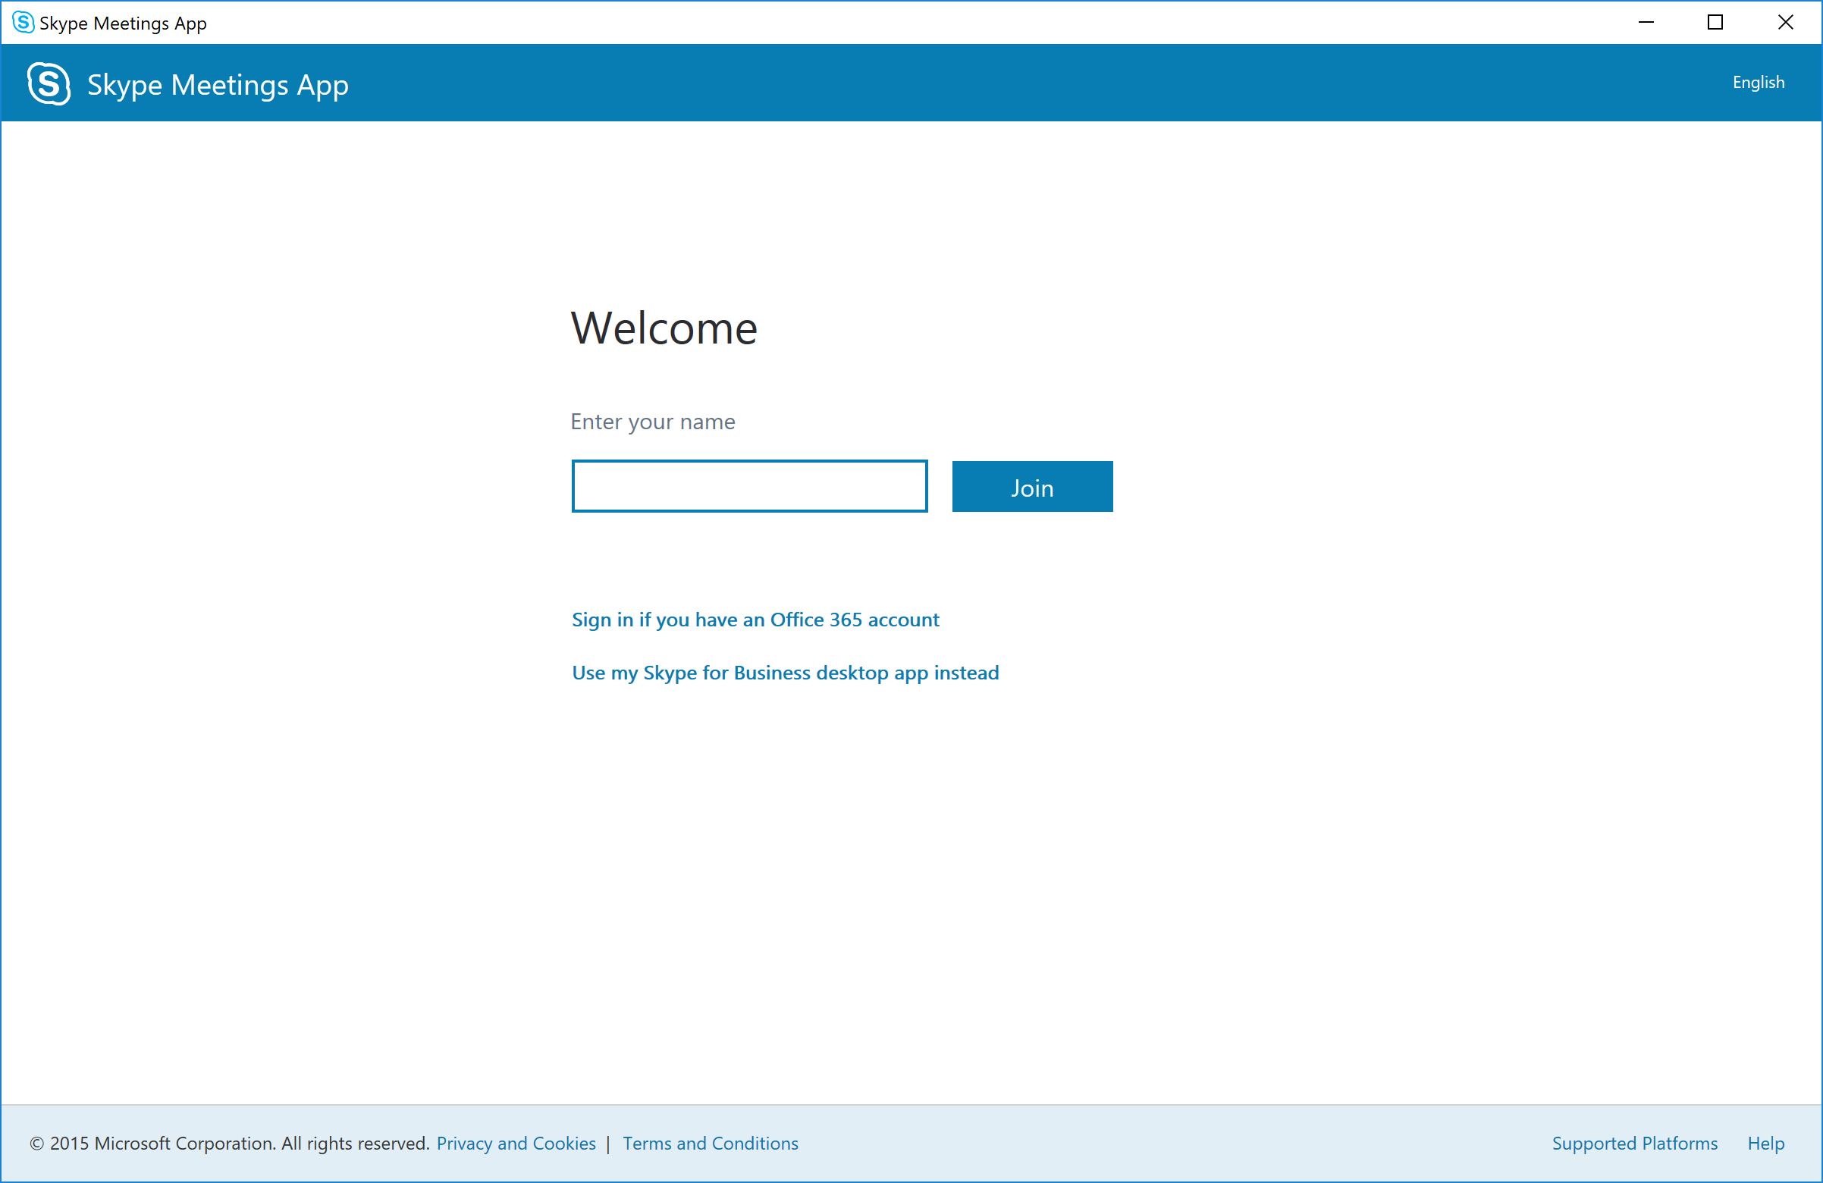
Joining a Skype for Business meeting from Outlook
Meetings Only (aka Native limited client) Skype for Business client launched with meetings only functionality
All future meetings launch Skype Meeting App
Web client requires one-time download and install of Skype Meetings App

Slide 23
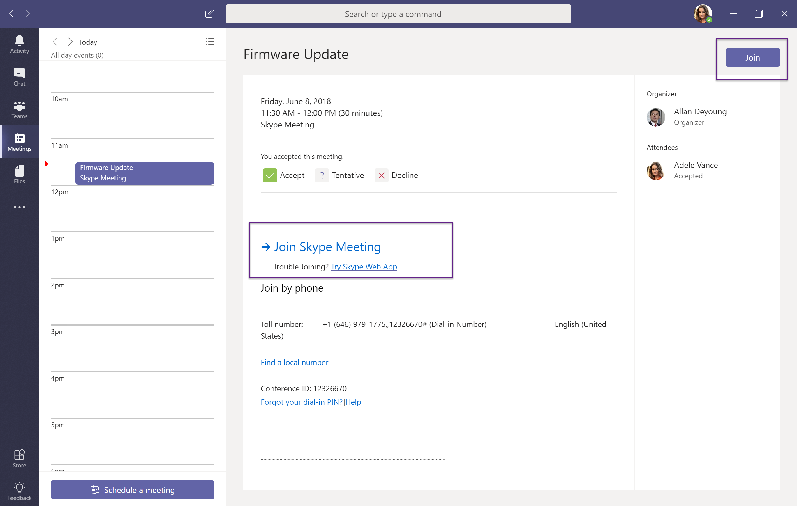
Joining a Skype for Business meeting from Teams
Meetings Only (aka Native limited client) Skype for Business client launched with meetings only functionality
All future meetings launch Skype Meeting App
Web client requires one-time download and install of Skype Meetings App

Slide 24
When Full Side-by-Side is not right for you?
Teams side-by-side to SFB with Chat, Meetings & Calling
Considerations:
Skype for Business Online and most on-premises
Capabilities available in both SFB and Teams
Enables quick velocity move to Teams
Teams side-by-side to SFB with selected features (Collab, Meetings)
Considerations:
More complex environment with on premises enterprise voice
No overlapping capabilities between SFB and Teams
Designed with longer co-existence period in mind

Slide 25
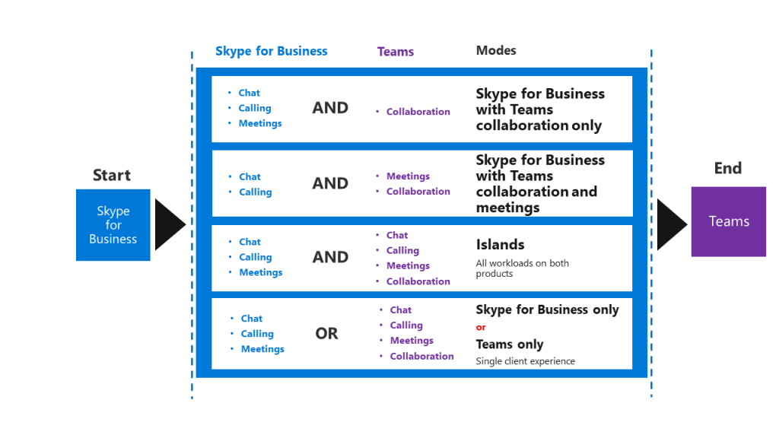
What If…

Slide 26
Exceptional situations for very large or complex organizations
Organizations may need / prefer not to use Full Side-by-Side
Need a fully deterministic process and timeline, rather than wait for adoption saturation
Concerned with user confusion and helpdesk when having client overlap
Require interop throughout the upgrade process
Regulatory or compliance need to keep some workloads or some users on-prem
Complex, sticky SfB Server Enterprise Voice deployment
Long term contracts with hosting provider for SfB Server
Fully supported, production alternative
Side-by-Side with Interop
Decouples IT actions up to upgrade from adoption saturation; requires strong IT
Keep in mind
Teams is more attractive when it is more complete; Side-by-Side with Interop starts with a less complete experience (chat and calling are in SfB, not in Teams)
Only should be used when required

Slide 27


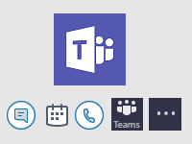
Side-by-Side with Interop: user perspective
+
Starting point: User is in Skype for Business, with all communication capabilities (chat, meeting scheduling, calling)
Introduce Teams to the user, without communications capabilities
All chats and calls continue to land in and originate from Skype for Business
User can explore net new functionality of Teams (Channels, Apps, Files, etc)
Switch communications functionality over to Teams
Non-upgraded users and upgraded users all have access to chat and calling interop to communicate

Slide 28


Side-by-Side with Interop, user perspective: Meetings First For complex organizations with Enterprise Voice
+
+
Begin State: User is in Skype for Business with UC functionality.
Introduce Teams to the user, without UC functionality, as previously described
Switch Meetings scheduling functionality from Skype for Business to Teams
Up to this point, all calls and chats initiate from and land in Skype for Business
Upgrade fully to Teams Only
Chat and calls between Upgraded (Teams Only) users and all other users benefit from interop

Slide 29
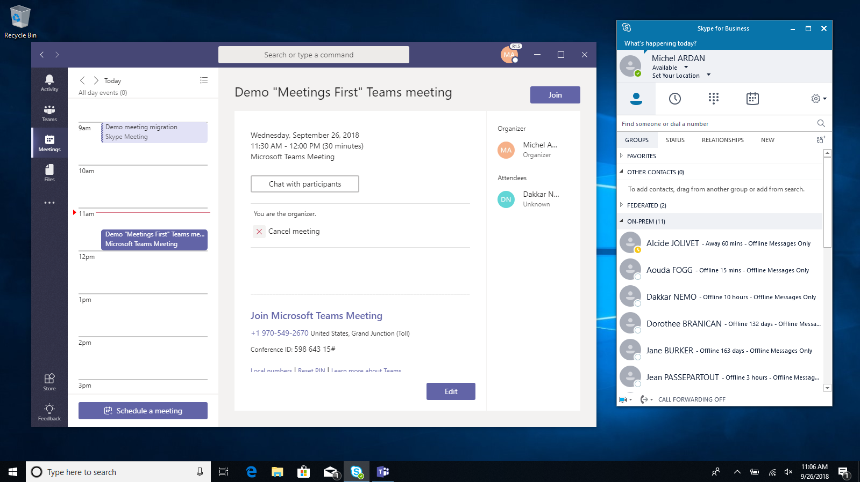
Why Meetings First
Keep running Skype for Business Server for chat, calling and presence
Address meetings now, Enterprise Voice and Chat next
Simplified, streamlined meetings centric Teams experience
Meet in Teams
Provide best, richest, complete meetings experience
Include meeting rooms, devices, services (Cloud Video Interoperability)
Enjoy harmonious coexistence
Your Teams and Skype for Business clients play nice with each other
Full IT story – provisioning, reporting…

Slide 30
Better Together
Control your device across Teams and Skype for Business
I can use my USB device’s mute unmute and hook controls across Teams meeting and Skype for Business call (in TAP – Windows and Mac)
Presence reconciliation
When I am in a Teams meeting, or presenting full screen, my presence in Skype for Business reflects it (in TAP – Windows; planned – Mac)
Hold on incoming call
When I am in a Teams meeting and place/accept a Skype for Business call, my Teams meeting goes automatically on hold (in-prod – Windows; planned – Mac)
➔ Meetings First delivers a superior experience to any third-party meeting solution when in coexistence with Skype for Business

Slide 31
Part 3: experiences in coexistence

Slide 32
What is coexistence? Introduction to modes…
Both Skype for Business and Teams present for the same user
Supported coexistence configurations (aka modes) for a user
Skype for Business only (SfBOnly) or Teams only (TeamsOnly)
Skype for Business and Teams – with overlap of capabilities between clients: Full Side-by-Side (Islands)
Skype for Business and Teams – no overlap of capabilities between clients: Side-by-Side with Interop (SfBWithTeamsCollab, SfBWithTeamsCollabAndMeetings)
Meeting participation is always possible in both clients, regardless of modes
No interop for meetings, but none needed
Special (meetings participation only) configuration of Teams in SfBOnly and or Skype for Business in TeamsOnly
Both Skype for Business and Teams present in the same organization
Customer deployments may involve users in different modes at any time, as well as users going through different modes at different times
Modes → building blocks of your journey, and what the IT Pros use to manage it

Slide 33
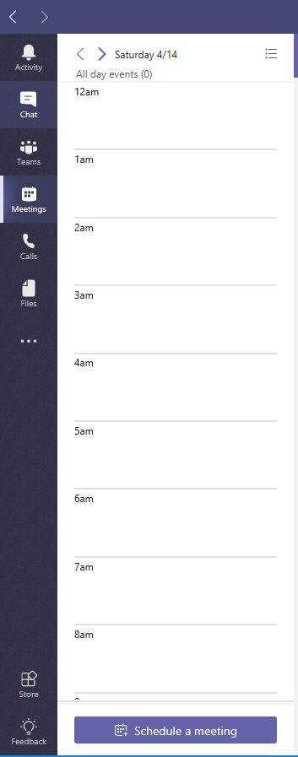
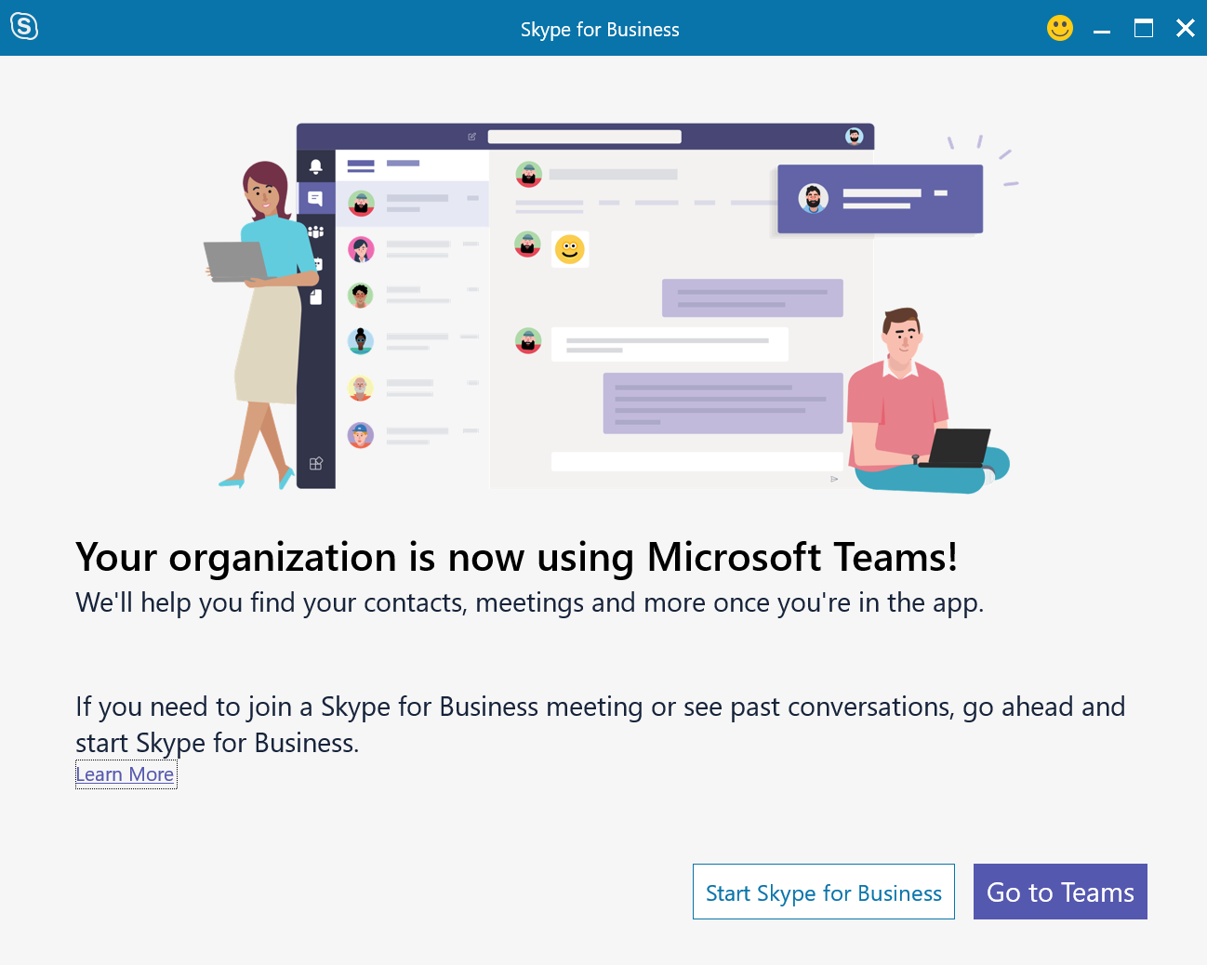
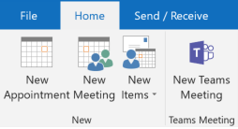
Teams Only User is upgraded to Microsoft Teams
Skype for Business
Teams
Meetings attendance only
Chat
Calling
Meetings
Collaboration
Calling and Chat
Meetings
Receives any chats and calls in Teams client, regardless of where initiated
Can only initiate chats and calls in Teams
Can continue to use Skype for Business IP phones
Teams presence is published to both systems
Meeting scheduling available only in Teams
Outlook shows only Teams add-in
Can join meetings from the respective clients
This is the end goal

Slide 34
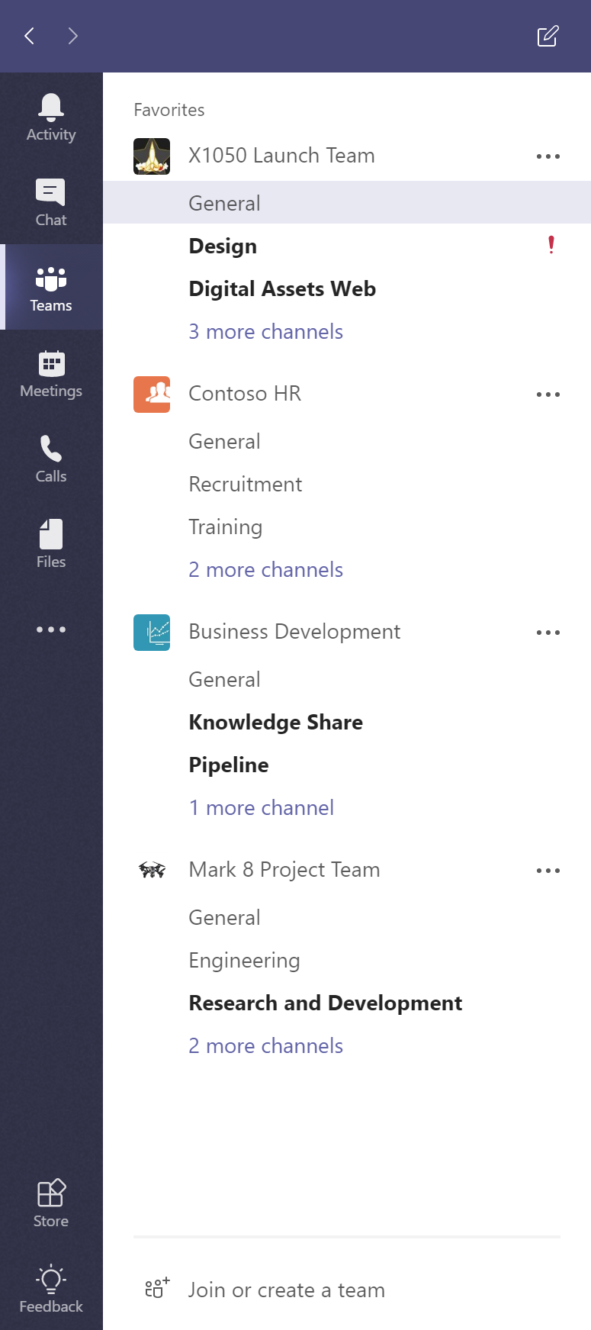
Islands (Option #1) Full Side-by-Side User runs both applications with “all” features available
Skype for Business
Teams
Chat
Calling
Meetings
Chat
Calling
Meetings
Collaboration
Calling and Chat
Meetings
Receives chats and calls in same client as the one used by originator
PSTN calls in one client only
Can initiate calls and chats from either client
Presence is separate
No interoperability
Meeting scheduling available on both services
Outlook shows both add-ins
Can join meetings from the respective clients
Default; requires strong Adoption and Change Management, adoption saturation prior to upgrade

Slide 35
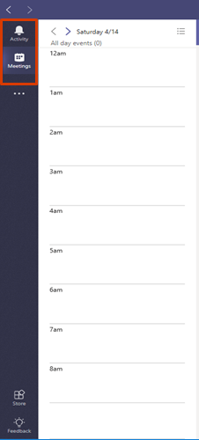
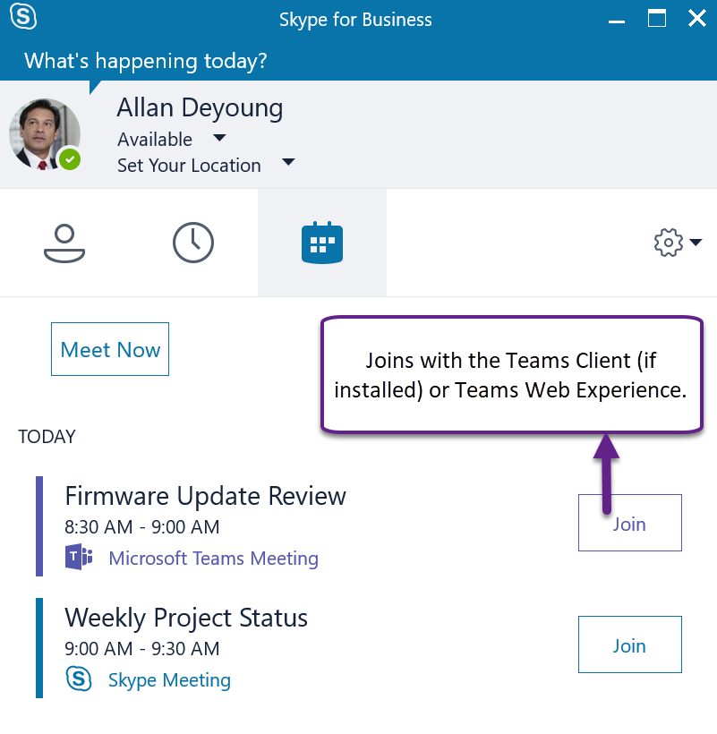
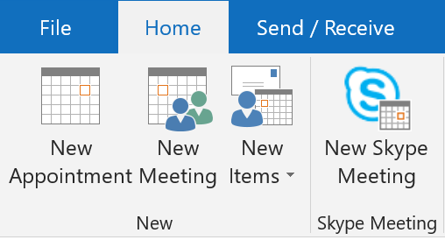
Skype for Business Only (Option #2) Side-by-Side with Interop Teams for authenticated meetings attendance only
Skype for Business
Teams
Chat
Calling
Meetings
Meetings attendance only
Calling and Chat
Meetings
Receives any chats and calls in Skype for Business client, regardless of where initiated
Can only initiate chats and calls in Skype for Business
Skype for Business presence is published to both systems
Interoperability available with Teams Only user
Meeting scheduling available only in Skype for Business
Outlook shows only Skype for Business add-in
Can join meetings from the respective clients
Special case for users who can’t have cloud

Slide 36
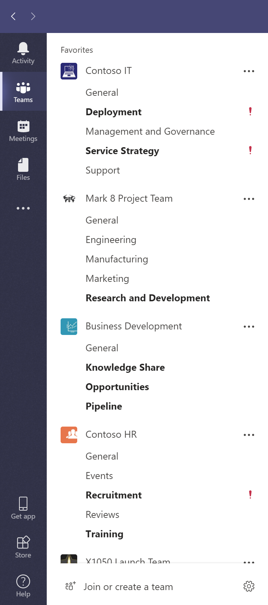
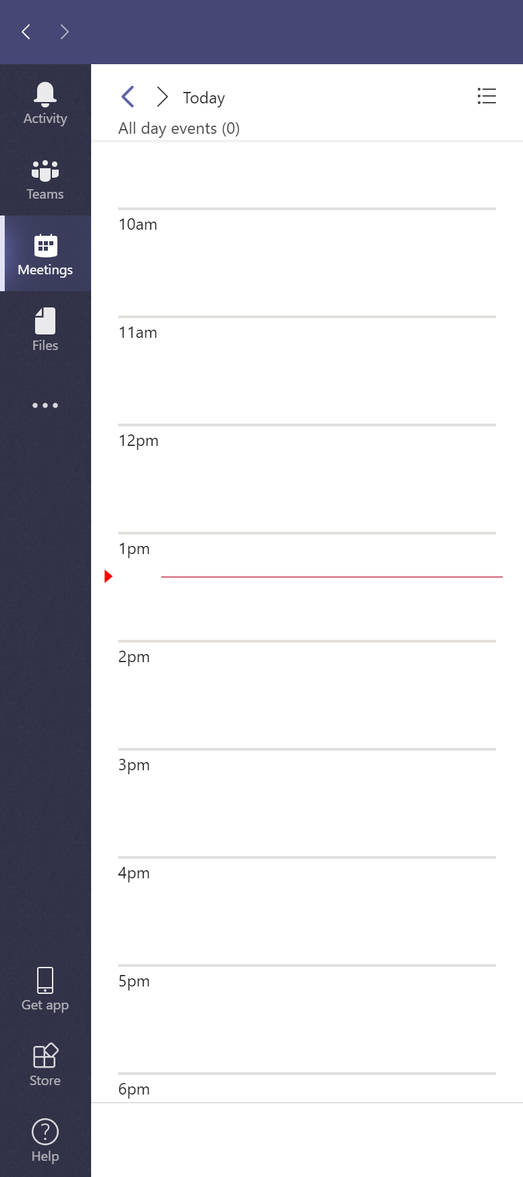
Skype for Business with Teams Collab (Option #2) Side-by-Side with Interop Teams for group collaboration (and meeting attendance)
Skype for Business
Teams
Chat
Calling
Meetings
Collaboration
Calling and Chat
Meetings
Receives any chats and calls in Skype for Business client, regardless of where initiated
Can only initiate chats and calls in Skype for Business
Skype for Business presence is published to both systems
Interoperability available with Teams Only user
Meeting scheduling available only in Skype for Business
Outlook shows only Skype for Business add-in
Can join meetings from the respective clients
Exceptional situations for very large or complex organizations; requires IT Pro setting, management

Slide 37
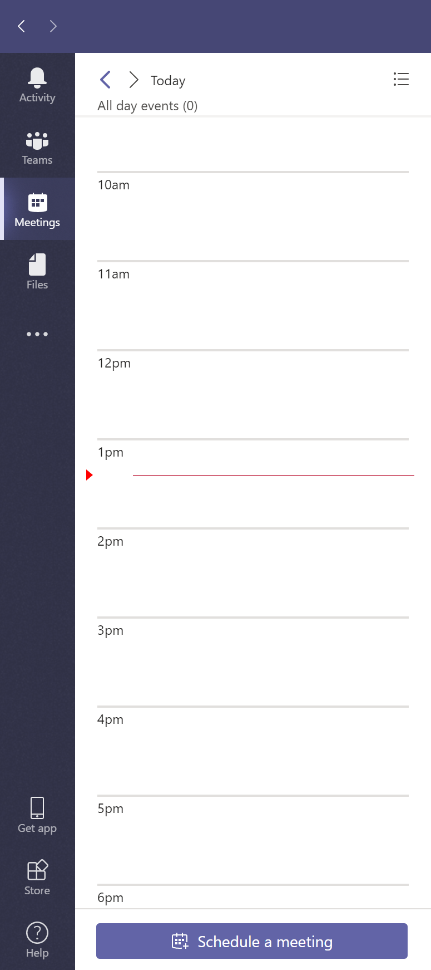
Skype for Business with Teams Collab and Meetings Side-by-Side with Interop Meetings First: Teams for group collaboration and meeting scheduling
Skype for Business
Teams
Chat
Calling
Meetings
Collaboration
Calling and Chat
Meetings
Receives any chats and calls in Skype for Business client, regardless of where initiated
Can only initiate chats and calls in Skype for Business
Skype for Business presence is published to both systems
Interoperability available with Teams Only user
Meeting scheduling available only in Teams
Outlook shows only Teams add-in
Can join meetings from the respective clients
Exceptional situations for very large or complex organizations; requires IT Pro setting, management

Slide 38
Coexistence modes
Mode | Calls and Chats | Meeting scheduling | Teams Channels available | Use case
Teams Only Requires home in Skype for Business Online | Teams | Teams | Yes | The final state of being upgraded Also default state for *new* tenants (<500 users)
Islands | Either | Either | Yes | Default recommendation and default configuration Allows a single user to evaluate both clients Side-by-Side. Chats and calls can land in either client; users must always run both clients; adoption is paramount to success
Skype for Business Only | Skype for Business | Skype for Business | No(*) | Specialized scenario for orgs with strict requirements (e.g. for data control); Teams is only used to join Teams meetings authenticated
Skype for Business With Teams Collab | Skype for Business | Skype for Business | Yes | Alternate starting point for complex orgs that need tighter admin control Calls and chats always routed to and from only one client throughout the migration.
Skype for Business With Teams Collab And Meetings | Skype for Business | Teams | Yes | “Meetings First” Enables on-prem customers to benefit from Teams meeting functionality, if not yet ready to move calling to the cloud; in TAP

Slide 39

Part 4: key considerations for migrating

Slide 40
Considerations for Skype for Business online orgs
Unless pure online organization All msRTCSIP attributes from on-prem must have been sync’d to Azure AD
Licenses are assigned Users are assigned E1, E3 or full E5 licenses, plus phone systems licenses as applicable
Meet Teams pre-requisites for access All pre-requisites met for users successfully reaching Office 365 Teams (4 ports, 2 subnets)
Follow Microsoft networking best practices High importance in all voice, conferencing and desktop sharing scenarios

Slide 41
Considerations for Skype for Business on-prem orgs
Azure AD Sync & Hybrid
All msRTCSIP attributes from on-prem must have been sync’d to Azure AD
Skype for Business must be configured in Hybrid if MOVING to Teams Only
Hybrid is NOT REQUIRED if using Modes (Option #2) although without Hybrid there is no Meeting Migration Service
Note: users with Skype for Business on-prem may use Teams, but
They cannot be “Teams Only”
They have no interop, no federation from their Teams client (must use Skype for Business client for this)
Migration
On-prem users must first be moved to online using Move-CsUser, in order to execute grant-csTeamsUpgradePolicy
1 step: use –MoveToTeams switch in Move-CsUser (requires Server 2019 or CU8 for 2015)
2 steps: use any version of Move-CsUser without the switch, then grant-csTeamsUpgradePolicy–PolicyName UpgradeToTeams
Results are same either way
1-step migration: meetings will be moved and converted directly to Teams
2-step migration: meetings moved first to Skype for Business Online, then converted to Teams

Slide 42
Microsoft Teams and Exchange on-premises
For the full Microsoft Teams experience, every user should be enabled for Exchange Online, SharePoint Online, OneDrive for Business and Office 365 Group creation.
eDiscovery
(messages, files)
Modify user profile picture
Legal hold
(messages, files)
Retention
(messages, files)
eDiscovery
(calling / meeting)
Team and Channel management
Add and configure connectors
Create and view meetings
Manage contacts
Add and configure bots
Call History
Voicemail
Access Outlook contacts
Add and configure tabs
Exchange Online | ✓ | ✓ | ✓ | ✓ | ✓ | ✓ | ✓ | ✓ | ✓ | ✓ | ✓ | ✓ | ✓ | ✓
Exchange Online Dedicated vNext | ✓ | ✓ | ✓ | ✓ | ✓ | ✓ | ✓ | ✓ | ✓ | ✓ | ✓ | ✓ | ✓ | ✓
Exchange Online Dedicated – Legacy | Yes (must be on allowed list) | ✕ | ✕ | Yes (must be on allowed list) | ✓ | ✕ | ✕ | ✓ | ✓ | ✕ | Yes (Exchange 2013+)* | ✕ | ✓ | ✓
Exchange on-premises | Yes (must be on allowed list) | ✕ | ✕ | Yes (must be on allowed list) | ✓ | Exchange 2016 CU3 or later | ✕ | ✓ | ✓ | ✕ | Yes (Exchange 2013+)* | ✕ | ✓ | ✓
https://docs.microsoft.com/en-us/microsoftteams/exchange-teams-interact

Slide 43
Considerations for Skype for Business on-prem orgs
Enabling Skype for Business hybrid is required to start moving to TeamsOnly
All msRTCSIP attributes from on-prem must have been sync’d to Azure AD
Note: users with Skype for Business on-prem may use Teams, but
They cannot be “Teams Only”
They have no interop, no federation from their Teams client (must use Skype for Business client for this)
Migration
On-prem users must first be moved to online using Move-CsUser, in order to execute grant-csTeamsUpgradePolicy
1 step: use –MoveToTeams switch in Move-CsUser (requires Server 2019 or CU8 for 2015)
2 steps: use any version of Move-CsUser without the switch, then grant-csTeamsUpgradePolicy –PolicyName UpgradeToTeams
Results are same either way
1-step migration: meetings will be moved and converted directly to Teams (in TAP)
2-step migration: meetings moved first to Skype for Business Online, then converted to Teams

Slide 44
Room Devices
Deploy Teams to Surface Hub
Download and install the Teams application from the app Store
Choose the default calling and meetings application (Sfb or Teams), USB or Intune
https://docs.microsoft.com/en-us/MicrosoftTeams/teams-surface-hub
Microsoft Teams Rooms (Formerly Skype Room Systems)
Teams support came with version 4.0.8 (July, 2018) of the store app and has been updated since
This comes via Windows updates and store updates to the room system application
https://docs.microsoft.com/en-us/skypeforbusiness/plan-your-deployment/clients-and-devices/srs2-release-note

Slide 45
Phones
Skype for Business phones will continue to work via Gateway until June 2023
Polycom (Poly) Trio
Current SfB firmware will join Teams meetings via gateway, if upgraded to Teams, can only join Teams meetings
Beta release is now available. Waiting GA for Trio 8800 and 8500
No support for Visual+ Devices unless using Polycom Real Connect Service in O365 (or similar solution)
Native Teams phones
Will only register to Teams

Slide 46
Part 5: planning is KEY!!!

Slide 47






Leverage the proven upgrade framework This end-to-end process can help you plan, manage and implement your upgrade to Teams
+
Project stakeholders
Project definition
Technical readiness and user readiness
Deployment and implementation
Operational excellence
Gather the right sponsors and project team
Define your project scope, goals, and timeline
Assess network readiness; test for quality
Assess user acceptance and design readiness
Implement pilot, coexist, and upgrade strategy
Drive value through optimization and adoption growth
Learn more at aka.ms/SkypeToTeams

Slide 48

Design a user readiness strategy
Define the value prop for your end users
Understand relevant personas, use cases and usage scenarios
Business goals (increase productivity, save money) are NOT user goals
1
Assess users’ propensity to change
How much change is happening?
What is your organizational change culture?
2
Identify the relevant readiness channels
Awareness, training and support
Communicate early. Don’t wait for completion of technical readiness
3
Build and implement your readiness plan
Utilize steps 1-3 to inform your plan
Align back with your technical team and project lead
4

Slide 49
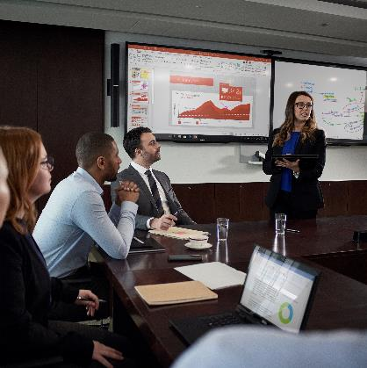


Implement your upgrade plan Important! Ground users in Teams first to help facilitate your upgrade over time
pilot
Opportunity to validate both technical and user readiness
Be a formal effort with a defined test plan and clear go/no-go goals
Include a good representation of your user base
coexist
Running Skype for Business and Teams together in your environment
Several upgrade approaches (modes) to meet your organization’s needs
upgrade
Moving users and your tenant to Teams only mode
Phased approach enables you to pause/mitigate if needed
Maintain momentum once you begin to alleviate users in too many modes

Slide 50
Establish your operational plan
Measure against your defined goals and mitigate as needed
Monitor network health to ensure a positive user experience
Maintain user excitement to sustain adoption and ROI
Plan for product innovations to optimize and grow

Slide 51
Lessons Learned
Interop User Expectations - Migrations not in logical user groups - Under estimating the user change (It’s not an upgrade!!!) - Under estimating policy implications - Under estimating Team creation sprawl - Under estimating Calling Features in SfB vs Teams - Federation (contacts, presence, confusion around guests) - ** Register Teams as default app for SIP and Tel Protocol - ** Attendee/Presenter Rights - SfB Meeting Join Experience changes for Teams Only Users (Public Preview) - Share desktop from Web App (Public Preview)
** Announced at Ignite

Slide 52
Like This Content
Teams Users Group Meetings
https://www.meetup.com/MNTeams/
Next Meeting: December 19th at 9:00 AM / MTC

